Slide 1
Wiwynn At-Scale Validation Cluster Training Package Rev1.1
LS Chong, Fancy Yang, Yu Jiang & Wenbin Chen
Q3 2021

Slide 2
Outlines
Admin Rack Architecture Overview
Login node
Infra node
Kubernetes cluster
OpenStack cluster
Storage
Kubernetes Cluster Architecture Overview
Architecture
Master Node
Worker Node
Metallb Load Balancer
Local Volume Provisioner
Common Kubernetes Commands

Slide 3
Outlines
OpenStack Cluster Overview
Architecture
API Interface
Ironic
Nova
Neutron
Glance
Cinder
Keystone
Designate
Common OpenStack Commands - TBD
Provisioning Process - TBD

Slide 4
Outlines
OOB Telemetry Service Overview
Architecture & Framework
BMC Exporter Redfish & IPMI
BMC Crashdump Collector
BMC SEL Collector
BMC Journal Collector
BMC SOL Collector
Prometheus Server
Grafana Dashboard
Elasticsearch & Kibana
In-band Telemetry Service Overview
Architecture & Framework
Process Overview
Backup

Slide 5
Admin Rack Architecture Overview
IT/Internet
Company subnet 10.x.x.x/x
SSH port 22
Login / Setup Host
BMC subnet 10.200.x.x/16
Min/Recommend: 1G NIC
Validation subnet 10.250.x.x/16
Min: 10G
Recommend: 10/25/40/100G depending on Test Validation use case
Infra
Admin subnet
10.243.x.x/16
Min: 10G
Recommend: 25G
Master (Kubernetes) x 3
Worker (Kubernetes) x 5
BMC
OOB Telemetry
SUT
Prometheus / Grafana
BMC
Elastic / Kibana
SUT
*Autonomous Crashdump
KAFKA
Logstash
BMC
SUT
Open Stack x3
Ironic
Nova
Storage x3
Docker Registry
In-band VMs x 9
S3web
VM
Inventory
VM

Slide 6
Admin Rack Architecture Overview
Login Node
Cluster’s jump host, allowing admin users to login to the cluster admin rack via SSH.
Deployment host for the cluster, all the cluster’s services deployment (ansible playbook, helm charts & etc.) are executed from this node.
Infra Node
Reserved.
Kubernetes Cluster (3 master nodes & 5 worker nodes)
Hold the overall cluster control plan.
Containers Orchestrator, managing all the pods (apps &services) that deployed on the cluster.
OpenStack Cluster (1 control node, 2 compute nodes)
Full OpenStack services are being deployed but it is mainly used for SUT’s & VMs provisioning.
Ironic, Nova, Designate, Neutron, Cinder, Glance & Keystone are the services that being deployed.
Storage (3 storage nodes)
Backend storage for the cluster, provides the NFS sharing, Docker registry & S3Web (Minio) services.
Mainly for docker images, open stack provisioning images (qcow2), VMs & inventory storage.

Slide 7
Kubernetes Cluster Architecture Overview
Admin
User
IP Pool
Load Balancer
10.243.100.12
10.243.100.13
10243.100.14
10.243.100.15
10.243.100.16
10.243.100.17
10.243.100.18
10.243.100.19
Master01, Master02, Master03
Worker01
Worker02
Worker03
Worker04
Worker05
MetalLB Load Balancer Controller
Kube-proxy
Kube-proxy
Kube-proxy
Kube-proxy
Kube-proxy
API Server
Kubelet
Kubelet
Kubelet
Kubelet
Kubelet
Control manager
Scheduler
Pods
(Apps / Services)
Pods
(Apps / Services)
Pods
(Apps / Services)
Pods
(Apps / Services)
Pods
(Apps / Services)
Local Volume Provisioner
etcd
Local Storage
Local Storage
Local Storage
Local Storage
Local Storage
Local Storage
Storage
NFS, Object

Slide 8
Kubernetes Cluster Overview
Architecture
Total of 8 bare metal nodes had been used in the setup where 3 for master nodes & 5 for worker nodes.
For optimization, two master nodes (master02 & master03) are configured to have two roles (master & worker). Hence, the total worker nodes become 7 (2 masters + 5 workers).
Master Nodes
Responsible for the overall management of the Kubernetes cluster, contains of 3 components that take care of communication, scheduling & controller:
API Server – Front end of the Kubernetes control plan, allowing user to interact with Kubernetes API via kubectl utility.
Control Manager – Central management of Kubernetes, consisted of multiple controllers:
Node controller – response for the worker state.
Replicated controller – maintain the correct number of pods.
Endpoint controller – joined services & pods together.
Service account & token controller – access management.
Scheduler – Watches, creates and assigned the pods to run on the designed nodes.
Etcd – Simple key value pair database to store cluster data including:
Job scheduling, pods details & state info.

Slide 9
Kubernetes Cluster Overview
Worker Nodes
It’s where all the pods (applications & services) operates, communicate back to Master Node via kubelet agent.
It’s consisted of 2 main components:
Kubelet – an agent that communicated back to the API server to check if the pods are being assigned to the node, execute pods container via container engine, mount pod volume & secret and response pod & node state back to master node.
Kube-proxy – network proxy & load balancer for the service on the single worker node. Handle network routing for TCP & UDP packets and perform connections forwarding.
MetalLB Load Balancer Controller
Allowing Kubernetes apps & services to be accessible from the external network (internet).
As the first interface with the external network that will manage all the loads & requests before assigning to the proper Kubernetes pods (apps & services) to prevent overloading.
Maintain an external IP’s pool that can expose the Kubernetes pods to the outside world. Total of 50 IPs had been reserved for MetalLB for this cluster with IP range: 10.250.100.50-10.250.100.100.
Local Volume Provisioner
Generates & manages the local persistent volume (LPV) from the local attached storage (physical disks).
The LPVs might be needed by some of the Kubernetes applications & services, for example Elastic search.
The “local-storage” LPV storage classes is generated for this Kubernetes cluster.

Slide 10
Kubernetes Cluster Overview
Common Kubernetes Commands (kubectl)
Kubectl get nodes – display all the nodes in the Kubernetes cluster.
Kubectl get pods –A – display all the pods in the Kubernetes cluster.
Kubectl get pods –n namespace –display all the pods in the namespace.
Kubectl get service –A – display all the services in the Kubernetes cluster.
Kubectl get service –n namespace – display all the services in the namespace.
Kubectl delete pods –n namespace – restart the pods.
Kubectl get pv – list down all the persistent volumes.
Kubectl get pvc –n namespace – list down all the persistent volumes claimed.
Kubectl exec –n namespace -c “container name” --stdin --tty “pod name” -- /bin/bash – login into the container inside the pod.
Kubectl cp “file to copy” -c “container name” namespace/”pod name”:”destination” – copy file into the container.

Slide 11
OpenStack Cluster Overview
Control01, Compute02, Compute03
(10.243.100.20, 10.243.100.21,10.243.100.22)
IPMI
SUT
IPMI
SUT
API Interface
Ironic
SUT
RedFish
Admin
User
Designate
SUT
RedFish
Keystone
Nova
100-400x or more
Neutron
Cinder
Glance
VM
VM
VM
Volumes
Images
Storage
VM

Slide 12
OpenStack Cluster Overview
API Interface
Provides a command-line client that enables you to access APIs through easy-to-use commands.
Ironic
Bare metal provisioning service for OpenStack
Nova
VM provisioning service for OpenStack
Neutron
Provides "networking as a service" between interface devices managed by other OpenStack services
Glance
Image service for OpenStack, provides image metadata & actual image
Cinder
Block Storage service for providing volumes to Nova VMs, Ironic BM hosts, containers and more.
Keystone
Identity service used by OpenStack for authentication (authN) and high-level authorization (authZ).
Designate
Provides multi-tenant DNSaaS service for OpenStack.

Slide 13
OpenStack Cluster Overview
SUT Provisioning Process
TBD

Slide 14
OOB Telemetry Services

Slide 15
OOB Telemetry Services Framework
OOB Telemetry
Worker (Kubernetes)
BMC Exporter
redfish
SUT
Grafana
redfish
OpenBMC
SUT
BMC Journal Collector
Prometheus
health
Web socket
health
ipmi sdr
SOL Collector
redfish
SUT
Admin
User
ipmi sol
Legacy
BMC
health
Kibana
Elastic Search
BMC SEL Collector
Ipmi sel
SUT
redfish
Crashdump Collector (*ACD)
health
*Autonomous Crashdump
SUT Inventory
(OpenStack Ironic)
Worker (Kubernetes)

Slide 16
OOB Telemetry Services at Wiwynn
OOB Telemetry
Worker (Kubernetes)
BMC Exporter - IPMI
SUT
Grafana
OpenBMC
SUT
BMC Journal Collector
Prometheus
Not Deployed
health
ipmi sdr
SOL Collector
SUT
Admin
User
ipmi sol
Legacy
BMC
health
Kibana
Elastic Search
BMC SEL Collector
ipmi sel
SUT
Crashdump Collector (*ACD)
Not Deployed
*Autonomous Crashdump
SUT Inventory
(OpenStack Ironic)
Worker (Kubernetes)

Slide 17
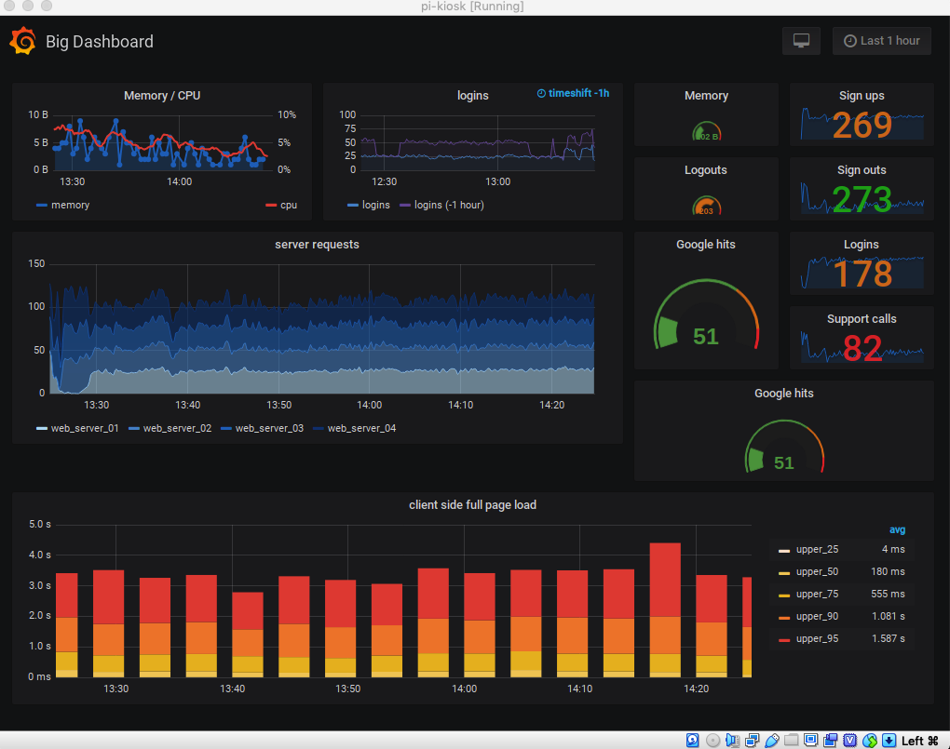
OOB Telemetry Services Overview
Not Deployed!
BMC Exporter redfish
The exporter is collecting all available OpenBMC sensors data via the available redfish endpoints.
Started as container running on unicorn HTTP server, listening at port 8080. using FastAPI interface.
Prometheus server sending query base on all registered SUTs inside the inventory files to BMC-exporter-redfish service through port 80 and the service will route the query to internal container port at 8080.
The container will then query the OpenBMC with list of available redfish endpoints:
Common redfish endpoints: /redfish/v1/SessionService, /redfish/v1/Managers, /redfish/v1/Chassis & /redfish/v1/Systems.
1. BMC-exporter-redfish Service Port: 80
3. Grafana
Service
2. Prometheus
Server
OpenBMC
Port: 80
Port: 80
Container Port: 8080
Inventory File

Slide 18
OOB Telemetry Services Overview
BMC Exporter IPMI
The exporter is collecting all available Legacy BMC sensors data via IPMI SDR.
Started as container running on unicorn HTTP server, listening at port 8080. using FastAPI interface.
Prometheus server sending query base on all registered SUTs inside the inventory files to BMC-exporter-ipmi service through port 80 and the service will route the query to internal container port at 8080.
The container will then query the Legacy BMC with IPMI SDR command.
1. BMC-exporter-IPMI Service
Port: 80
3. Grafana
Service
2. Prometheus
Server
Legacy BMC
Port: 80
Port: 80
Container Port: 8080
Inventory File

Slide 19
OOB Telemetry Services Overview
Deployment Tasks:
BMC exporter container image:
Establish session with BMC.
Retrieve the sensors value via the redfish endpoints / IPMI SDR.
Convert the values to Prometheus metrics.
Prometheus server
Retrieve SUTs information from ironic inventory file.
Sending the collect command to exporter for each SUTs to collect the metrics.
Grafana dashboards
Plot graphical diagrams based on the Prometheus metrics.

Slide 20
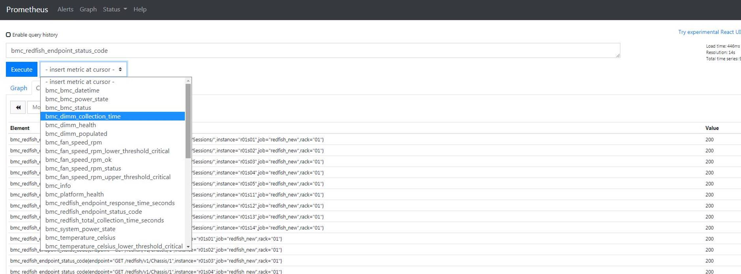
OOB Telemetry Services Overview
Example of Prometheus Metrics

Slide 21
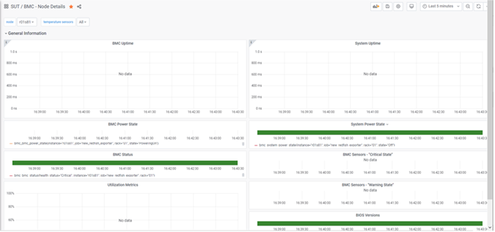
OOB Telemetry Services Overview
Example of redfish exporter dashboards

Slide 22
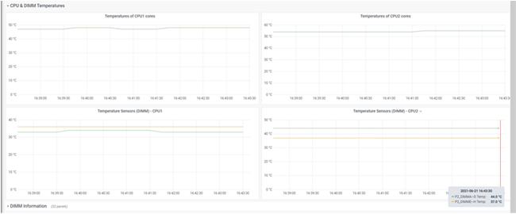
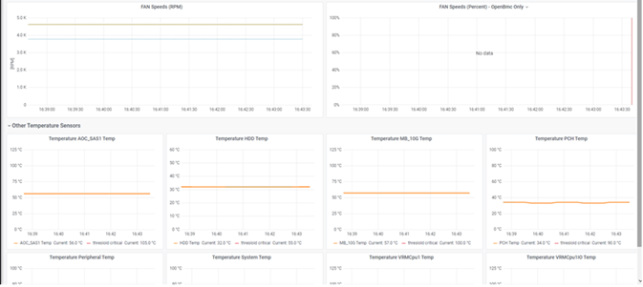
OOB Telemetry Services Overview
Example of redfish exporter dashboards

Slide 23
OOB Telemetry Services Overview
Not Deployed!
BMC Crashdump Collector
The crashdump collector is collecting the silicon registers’ dump data when there is a CPU CATERR or IERR errors detected on the platform.
The collector will either checking the SEL for the CATERR / IERR or using the PECI interface to directly probe the CPU for any CATERR / IERR.
The crashdump summarizer is running as the http web service that listening to port 8080. The summarizer is a container with PythonSV Cscripts installed for data summarizing.
The raw data that collected from BMC will be sending over to the summarizer for data summarizing.
The summarized data will then be sending over to KAFKA broker service under topic: crashdumps.
The Logstash service that subscribed to crashdumps topic will receive the data from KAFKA and send the data over to Elasticsearch with index: crashdumps*.
The Autonomous crashdump (ACD) with external redfish endpoint support from BMC is required.

Slide 24
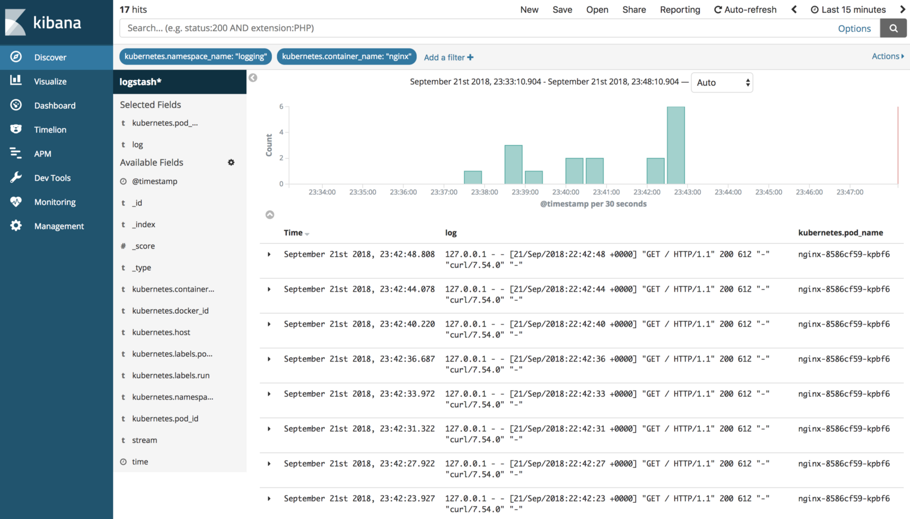
OOB Telemetry Services Overview
OpenBMC
Not Deployed!
SEL
Crash
dumps
CATERR
/ IERR
1. BMC Crashdumps
Collector
3. KAFKA
Topic: crashdumps
5. Elasticsearch
Index: crashdumps
4. Logstash
6. Kibana
2. BMC Crashdumps
Summarizer
(http web service
at port: 8080)
PythonSV
Cscripts

Slide 25
OOB Telemetry Services Overview
Deployment Tasks:
Crashdump collector container image:
Establish session with BMC.
Checking for CATERR/IERR from SEL or PECI Interface.
Generating & downloading the crash dump raw data via ACD.
Sending over the raw data to summarizer.
Collect the summarized data and send it to KAFKA broker.
Crashdump summarizer web service
Receiving the raw data from collector, summarize the data with PythonSV Cscripts and send it back to collector.
KAFKA broker
Receiving summarized data from collector under topic: crashdumps.
Logstash service
Collecting the data from KAFKA topic crashdumps and send it over to Elasticsearch with index crashdumps.
Elasticsearch
Database to keep the crashdump data.
Kibana
Plot graphical diagrams based on Elasticsearch data.
Not Deployed!

Slide 26
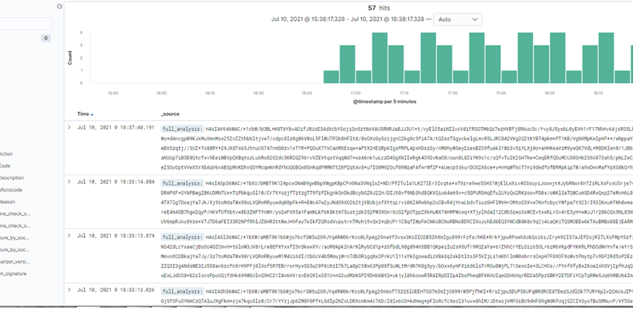
OOB Telemetry Services Overview
Example of Crashdump in Kibana
Not Deployed!

Slide 27
OOB Telemetry Services Overview
Not Deployed!
BMC SEL collector redfish
The BMC SEL collector is collecting system event log from OpenBMC via redfish endpoints.
The event logs data are sent over to Kafka under topic: bmc_sel.
Logstash service will finally transfer the data from KAFKA to Elasticsearch under index: bmc_sel.
Common redfish commands:
/redfish/v1/SessionService/Sessions
/redfish/v1/Systems/system/LogServices/EventLog/Entries
OpenBMC
1. BMC SEL
Collector
2. KAFKA
Topic: bmc_sel
4. Elasticsearch
Index: bmc_sel
SEL
3. Logstash
5. Kibana

Slide 28
OOB Telemetry Services Overview
BMC SEL collector IPMI
The BMC SEL collector is collecting system event log from legacy BMC via IPMI SEL commands.
The event logs data are sent over to Kafka under topic: bmc_sel.
Logstash service will finally transfer the data from KAFKA to Elasticsearch under index: bmc_sel.
Legacy BMC
1. BMC SEL
Collector
2. KAFKA
Topic: bmc_sel
4. Elasticsearch
Index: bmc_sel
SEL
3. Logstash
5. Kibana

Slide 29
OOB Telemetry Services Overview
Deployment Tasks:
BMC SEL collector container image:
Establish session with BMC.
Collect the SEL data and send it to KAFKA broker.
KAFKA broker
Receiving SEL data from collector under topic: bmc_sel.
Logstash service
Collecting the data from KAFKA topic bmc_sel and send it over to Elasticsearch with index bmc_sel.
Elasticsearch
Database to keep the SEL data.
Kibana
Plot graphical diagrams based on Elasticsearch data.

Slide 30
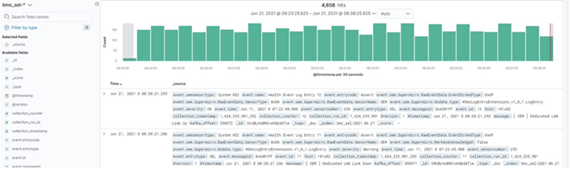
OOB Telemetry Services Overview
Example of BMC SEL in Kibana

Slide 31
OOB Telemetry Services Overview
Not Deployed!
BMC journal collector redfish
The BMC journal collector is collecting the journal (BMC logs) from OpenBMC via the redfish endpoints.
The journal data are sent over to KAFKA under topic: bmc_journal.
Logstash service will finally transfer the data from KAFKA to Elasticsearch under index: bmc_journal.
Common Redfish commands:
/redfish/v1/SessionService/Sessions
/redfish/v1/Managers/bmc/LogServices/Journal/Entries
OpenBMC
1. BMC Journal
Collector
2. KAFKA
Topic: bmc_journal
4. Elasticsearch
Index: bmc_journal
Journal
3. Logstash
5. Kibana

Slide 32
OOB Telemetry Services Overview
Not Deployed!
Deployment Tasks:
BMC SEL collector container image:
Establish session with BMC.
Collect the BMC journal data and send it to KAFKA broker.
KAFKA broker
Receiving SEL data from collector under topic: bmc_journal.
Logstash service
Collecting the data from KAFKA topic bmc_journal and send it over to Elasticsearch with index bmc_journal.
Elasticsearch
Database to keep the BMC journal data.
Kibana
Plot graphical diagrams based on Elasticsearch data.

Slide 33
OOB Telemetry Services Overview
Example of BMC journal in Kibana
Not Supported

Slide 34
OOB Telemetry Services Overview
BMC sol collector redfish & IPMI
The BMC SOL collector is redirecting the SOL streaming messages into local log files either via SOL web socket or IPMI SOL command.
The SOL data will be written into log files (based on node name) as a persistent buffer to store the data to prevent data loss when Kafka broker is offline and the data sending can be resumed once the Kafka is back online.
The Fluentd service (producer) will transfer the data from the log files to KAFKA with topic sol and the Logstash service (consumer) will finally transfer the data to Elasticsearch under topic: sol.
BMC
1. BMC SOL
Collector
SOL
Log files
2. Fluentd
3. KAFKA
Topic: sol
5. Elasticsearch
Index: sol
SOL
4. Logstash
6. Kibana
Notes:
Centos also send data to SOL
Exploring the BMC console option,

Slide 35
OOB Telemetry Services Overview
Redfish
Login to BMC through REST API (https), spawn new process for each node through multiprocessing.
Connect to the BMC web socket (need BMC support) and start streaming the SOL data.
Commands:
Login: POST https://IP/login
Logout: POST https://IP/logout
Web Socket: wss://IP/console0
IPMI
Spawn child process for every single node through python pexpect.
Connect to the SOL through the IPMI SOL command:
Ipmitool –I lanplus –H IP –U user –P pass sol set enabled true
Ipmitool –I lanplus –H IP –U user –P pass sol activate

Slide 36
OOB Telemetry Services Overview
Deployment Tasks:
BMC SOL collector container image:
Establish session with BMC.
Redirect the SOL streaming data into log files based on node’s name.
Fluentd
Parse the log files and send the data to KAFKA with topic: sol.
KAFKA broker
Receiving SOL data from fluentd under topic: sol.
Logstash service
Collecting the data from KAFKA topic sol and send it over to Elasticsearch with index sol.
Elasticsearch
Database to keep the sol data.
Kibana
Plot graphical diagrams based on Elasticsearch data.

Slide 37
OOB Telemetry Services Overview
Example of SOL in Kibana

Slide 38
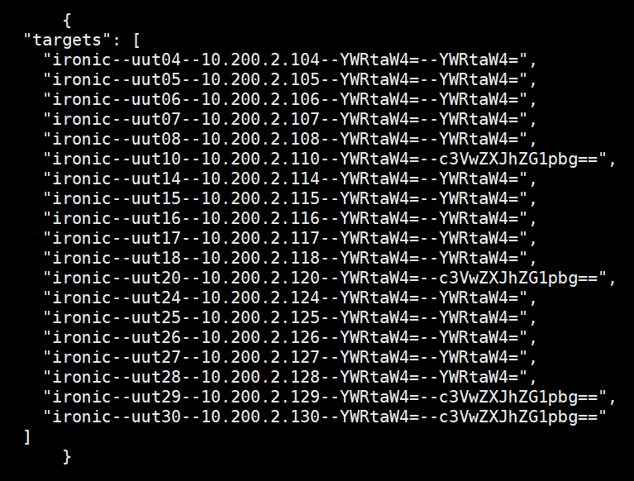
Add new SUT into OOB Telemetry Service
ssh storage01
Edit /mnt/Pool01/cluster-inventory/inventory/ipmi-prometheus.json
Add new SUT with same format
Ironic—name—ip--usr—pwd
Should use decode base 64 for
the usr and pwd
i.e. echo -n "admin"|base64

Slide 39
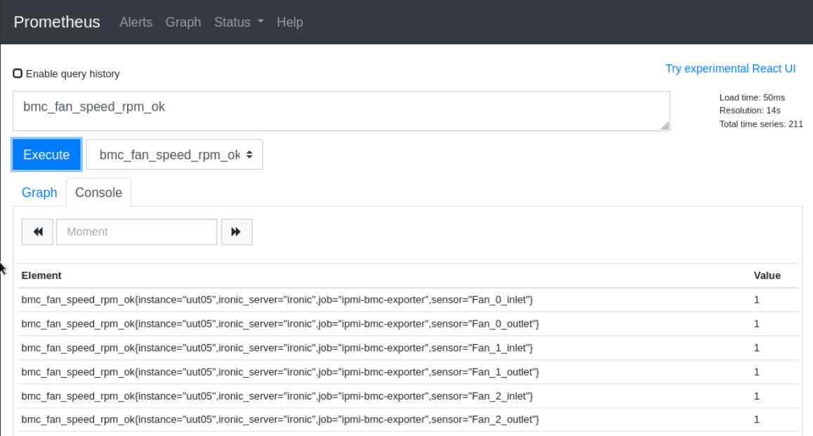
Prometheus Server
http://10.250.100.54:9090/graph no password
choose one metric and click execute, then value would be showed.

Slide 40
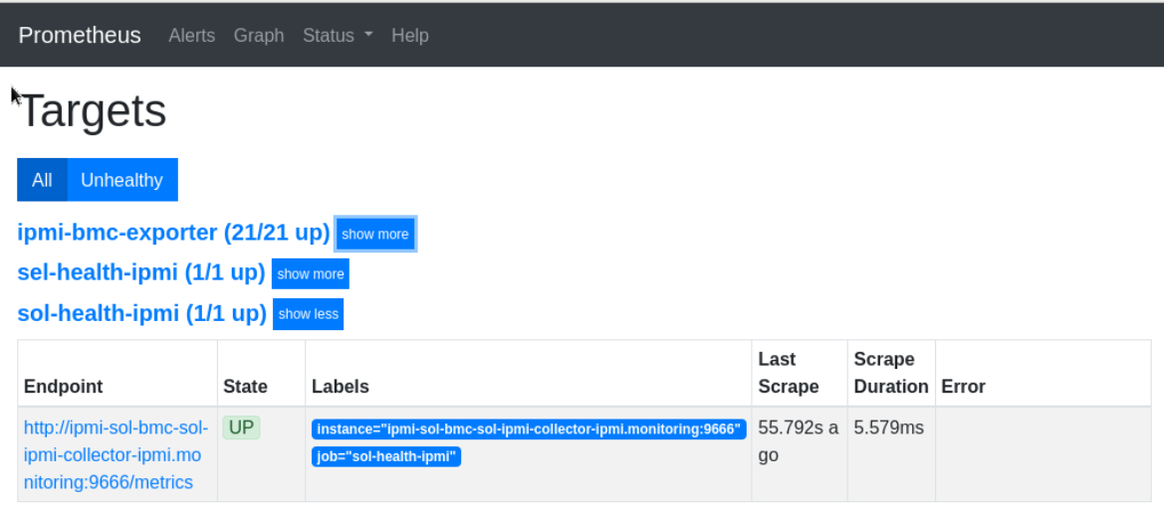
Prometheus Server
http://10.250.100.54:9090/targets
Display the status of the SUT with “up” or “down”.
You can also find the details of the SUT with name and IP.

Slide 41
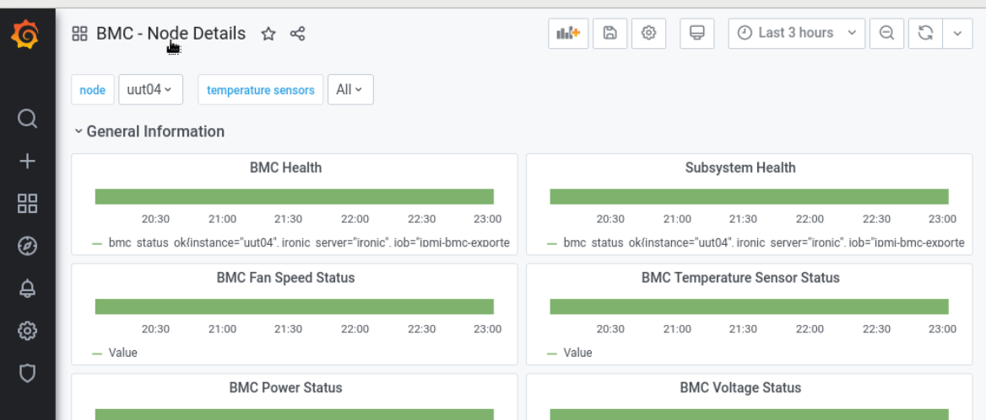
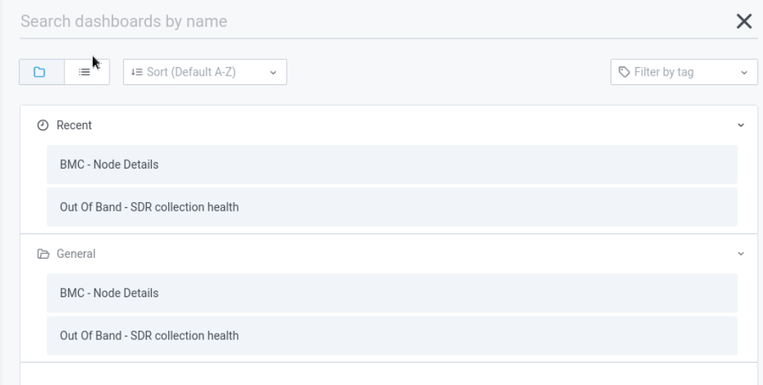
Grafana Dashboards
http://10.250.100.51:3000/login
username: admin password: grafana
Click here to choose BMC-Node Details

Slide 42
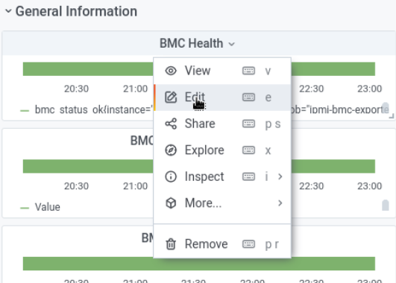
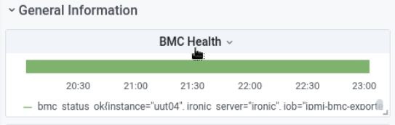
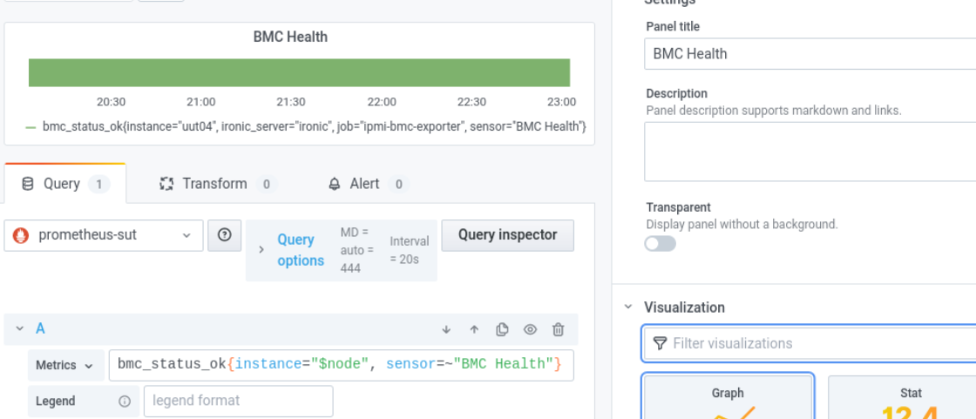
Grafana Dashboards
Click the title of one diagram you want to edit
Then click “Edit” to enter “Edit Panel”

Slide 43
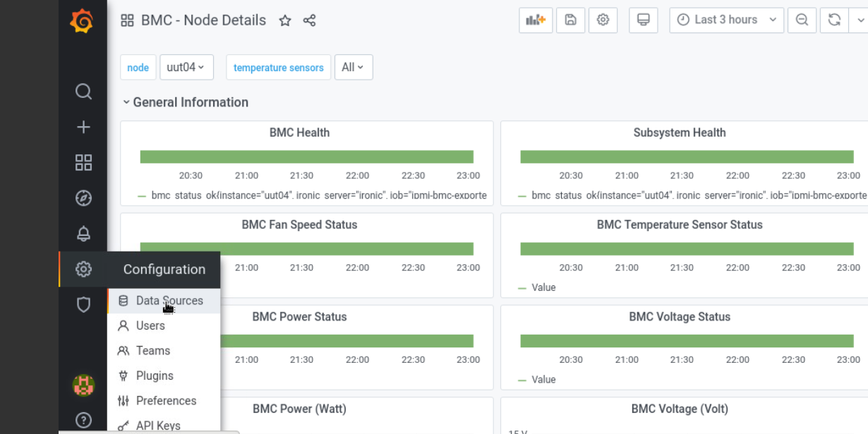
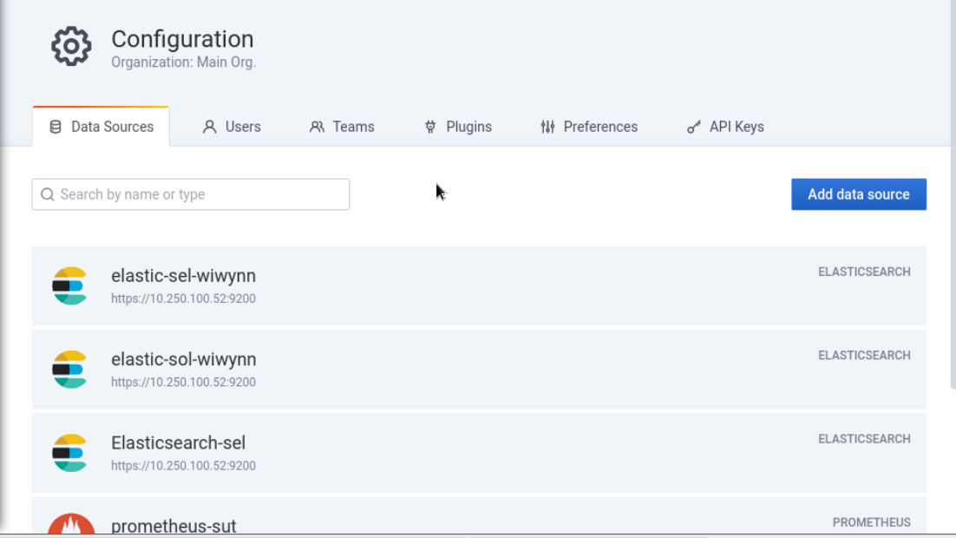
Grafana Dashboards
Click Data Source on the left bar
You could add source here

Slide 44
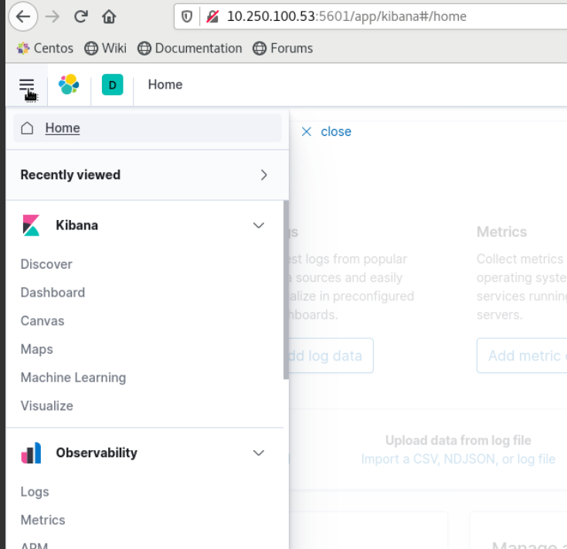
Elasticsearch & Kibana
http://10.250.100.53:5601/app/kibana#/
Usr: elastic Pwr: nW6ETD4kUv6fl97i651M81zR
Click the icon on the left corner

Slide 45
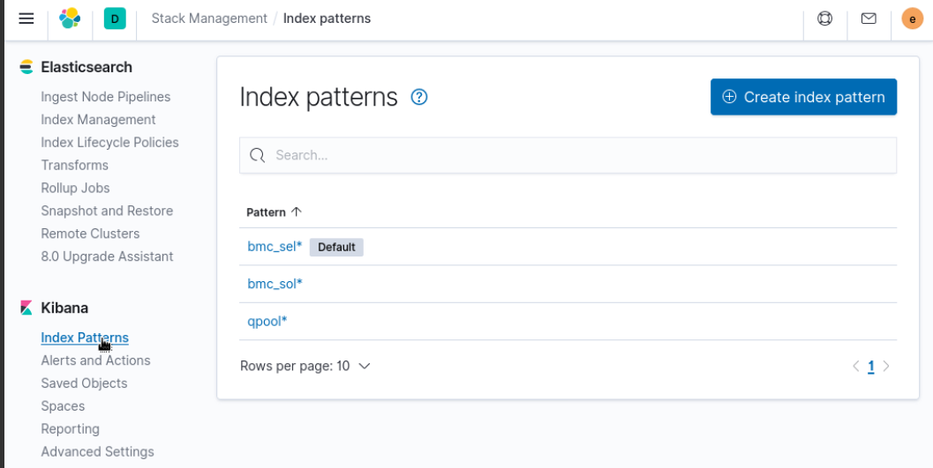
Elasticsearch & Kibana
Stack Management -> Index Pattern
Here could create index pattern

Slide 46
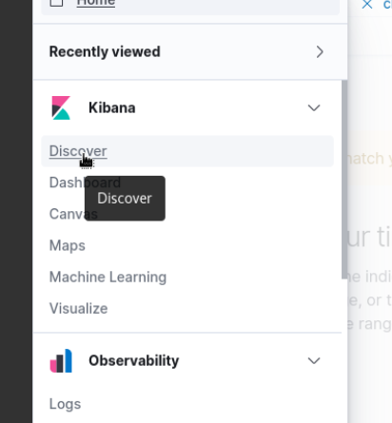
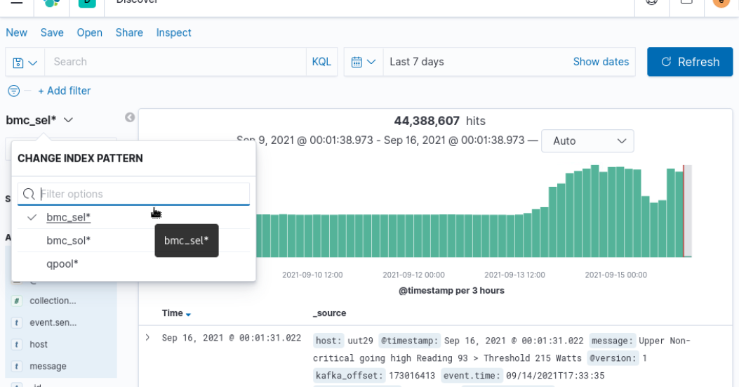
Elasticsearch & Kibana
Kibana-> Discover
Choose one index pattern to get diagram

Slide 47
Elasticsearch & Kibana

Slide 48
In-band Telemetry Services

Slide 49
In-band Telemetry Service Overview
Container / VM Orchestrator
(Kubernetes / KVM)
SUT
Container
SUT
Container
Validation Test
Validation Test
SUT
VM
Validation Test
SUT
VM
Telemetry
Prometheus
Metrics/ Logs
ElasticSearch

Slide 50
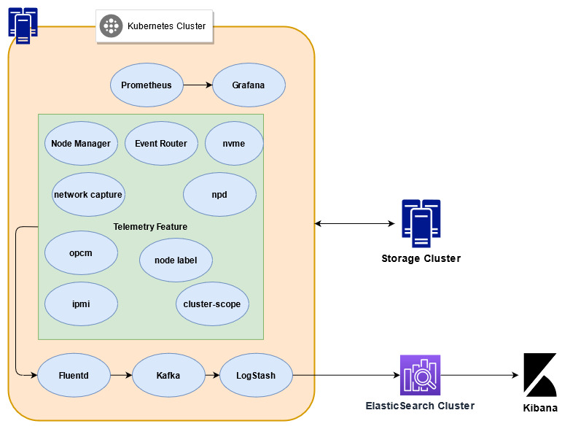
In-band Telemetry Service Overview

Slide 51
In-band Telemetry Services Overview
Feature:
Node Manager:
In band heartbeat, that tracks if a node is up.
Machine fingerprinters, captures machine details at each boot/reboot.
Capturing kernel log messages (dmesg).
Capturing mcelog messages
Capturing critical journal messages
Event Router
Captures all critical kubernetes events.
Sending the collect command to exporter for each SUTs to collect the metrics.
Inband and Serial Network Monitor
Detects any network instability and logs the same both to inband telemetry and via Serial to OOB telemetry

Slide 52
In-band Telemetry Services Overview
Feature:
Node Problem Detector:
Detects any issues in the cluster from multiple sources, kernel, journal and converts them to kubernetes eventsMachine fingerprinters, captures machine details at each boot/reboot.
The Event router then aggregates them.
Node Tracker
Propagates Node Labels to workloads.
This allows us to track workloads, failures etc using node labels.
Nvme Telemetry
Tracks NVMe specific telemetry
PCM
Tracks Node Level Perf Counters

Slide 53
In-band Telemetry Services Overview
Feature:
Inband IPMI collector:
Collector IPMI sensor data inband.
Cluster Scope Metadata
Create / Update metadata from cluster scope.

Slide 54
Backup

Slide 55
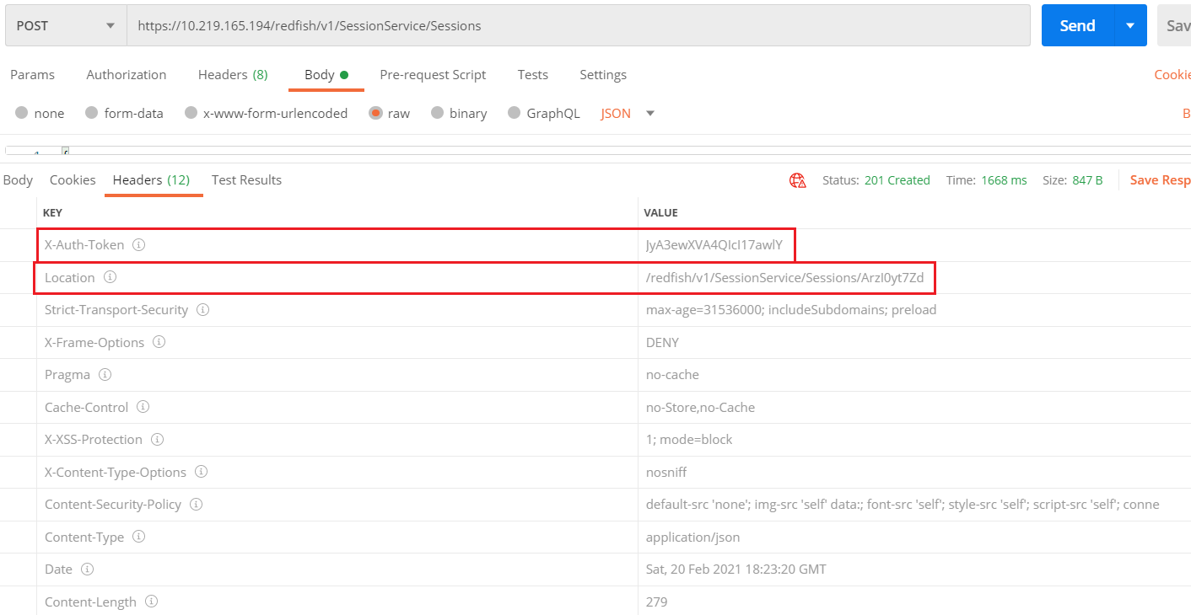
OOB Telemetry Services 2.0 Overview
Redfish session overview
Login with /redfish/v1/SessionService/Sessions.
Get X-Auth-Token: JyA3ewXVA4QIcI17awlY & Location: /redfish/v1/SessionService/Sessions/ArzI0yt7Zd
Logout: delete Location: /redfish/v1/SessionService/Sessions/ArzI0yt7Zd

Slide 56
OOB Telemetry Services 2.0 Overview
Prometheus Metrics Lists
Prometheus Metrics Groups | Sensors / Parameter Name | Intel redfish endpoints | FTX redfish endpoint
bmc_bmc_datetime* | DateTime | /redfish/v1/Managers/bmc | /redfish/v1/Managers/1
bmc_bmc_last_reset_time* | LastResetTime | /redfish/v1/Managers/bmc | /redfish/v1/Managers/1
bmc_bmc_power_state* | PowerState | /redfish/v1/Managers/bmc | /redfish/v1/Managers/1
bmc_bmc_status* | Status | /redfish/v1/Managers/bmc | /redfish/v1/Managers/1
bmc_dimm_collection_time bmc_dimm_health bmc_dimm_populated | dimm xx | /redfish/v1/Systems/system/Memory | /redfish/v1/Systems/1/Memory
bmc_fan_speed_percent bmc_fan_speed_percent_status | Pwm x | /redfish/v1/Chassis/R4000_Chassis/Thermal /redfish/v1/Chassis/AC_Baseboard/Thermal | /redfish/v1/Chassis/1/Thermal
 | Pwm PSUx Fan x
bmc_fan_speed_rpm bmc_fan_speed_rpm_status bmc_fan_speed_rpm_lower_threshold_critical bmc_fan_speed_rpm_lower_threshold_non_critical | Fan x | /redfish/v1/Chassis/R4000_Chassis/Thermal /redfish/v1/Chassis/AC_Baseboard/Thermal | /redfish/v1/Chassis/1/Thermal
bmc_info* | FirmwareVersion BiosVersion | /redfish/v1/Managers/bmc /redfish/v1/Systems/System | /redfish/v1/Managers/1 /redfish/v1/Systems/1
bmc_redfish_endpoint_response_time_seconds | http tend - tstart | NA | NA
bmc_redfish_endpoint_status_code | http status code | NA | NA
bmc_redfish_total_collection_time_seconds | total tend - tstart | NA | NA
bmc_sensor_a bmc_sensor_a_status | PSU1 Input Current | /redfish/v1/Chassis/AC_Baseboard/Sensors/ | /redfish/v1/Chassis/1/Sensors/
 | PSU1 Output Current
 | PSU2 Input Current
 | PSU2 Output Current
bmc_sensor_amperes bmc_sensor_amperes_status | PSU1 Input Current | /redfish/v1/Chassis/WC_Baseboard/Sensors/ | /redfish/v1/Chassis/1/Sensors/
 | PSU1 Output Current
 | PSU2 Input Current
 | PSU2 Output Current
bmc_sensor_percent bmc_sensor_percent_status | Host Cpu Utilization | /redfish/v1/Chassis/WC_Baseboard/Sensors/ /redfish/v1/Chassis/AC_Baseboard/Sensors/ | /redfish/v1/Chassis/1/Sensors/
 | Host Memory Bandwidth Utilization
 | Host Pci Bandwidth Utilization

Slide 57
OOB Telemetry Services 2.0 Overview
Prometheus Metrics Lists
bmc_sensor_w bmc_sensor_w_status | Cpu Power Average CPU1 | /redfish/v1/Chassis/AC_Baseboard/Sensors/ | /redfish/v1/Chassis/1/Sensors/
 | Cpu Power Average CPU2
 | Dimm Power Average CPU1
 | Dimm Power Average CPU2
bmc_sensor_watts bmc_sensor_watts_status | Cpu Power Average CPU1 | /redfish/v1/Chassis/WC_Baseboard/Sensors/ | /redfish/v1/Chassis/1/Sensors/
 | Cpu Power Average CPU2
 | Dimm Power Average CPU1
 | Dimm Power Average CPU2
bmc_system_last_reset_time* | LastResetTime | /redfish/v1/Systems/System | /redfish/v1/Systems/1
bmc_system_power_state* | PowerState | /redfish/v1/Systems/System | /redfish/v1/Systems/1
bmc_temperature_celsius bmc_temperature_celsius_status bmc_temperature_celsius_lower_threshold_non_critical bmc_temperature_celsius_upper_threshold_critical bmc_temperature_celsius_upper_threshold_non_critical | BMC Temp | /redfish/v1/Chassis/WC_Baseboard/Thermal /redfish/v1/Chassis/AC_Baseboard/Thermal | /redfish/v1/Chassis/1/Thermal
 | CPUx P12V PVCCIN VR Temp
 | CPUx P12V PVCCIO VR Temp
 | CPUx VR Mem ABCD Temp
 | CPUx VR Mem EFGH Temp
 | CPUx VR P1V8
 | Core xx CPU x
 | DIMM xx CPU x
 | DTS CPU x
 | Die CPU x
 | Exit Air Temp
 | Front Panel Temp
 | Inlet BRD Temp
 | Left Rear Board Temp
 | PCH M 2 Temp
 | Right Rear Board Temp
 | SSB Temp
 | CPUx North VR Temp
 | CPUx PVCCD VR Temp
 | CPUx PVCCFA EHV FIVRA VR Temp
 | CPUx South VR Temp
 | CPUx PVCCIN VR Temp
 | PSUx Temperature

Slide 58
OOB Telemetry Services 2.0 Overview
Prometheus Metrics Lists
bmc_voltage_volts bmc_voltage_volts_lower_threshold_critical bmc_voltage_volts_lower_threshold_non_critical bmc_voltage_volts_status bmc_voltage_volts_upper_threshold_critical bmc_voltage_volts_upper_threshold_non_critical | A P12V PSU SCALED | redfish/v1/Chassis/WC_Baseboard/Power redfish/v1/Chassis/AC_Baseboard/Power | redfish/v1/Chassis/1/Power
 | P105 PCH AUX
 | P12V AUX
 | P1V8 AUX
 | P3V3
 | P3VBAT
 | P5V
 | PSUx Input Voltage
 | PVCCD HV CPUx
 | PVCCFA EHV FIVRA CPUx
 | PVCCIN CPUx
 | PVCCINFAON CPUx
 | PVNN PCH AUX
 | PVCCIO CPU x
 | PVDQ ABC CPUx
 | PVDQ DEF CPUx
* Metrics with hardcoded endpoints.
Whitley EGS

Slide 59
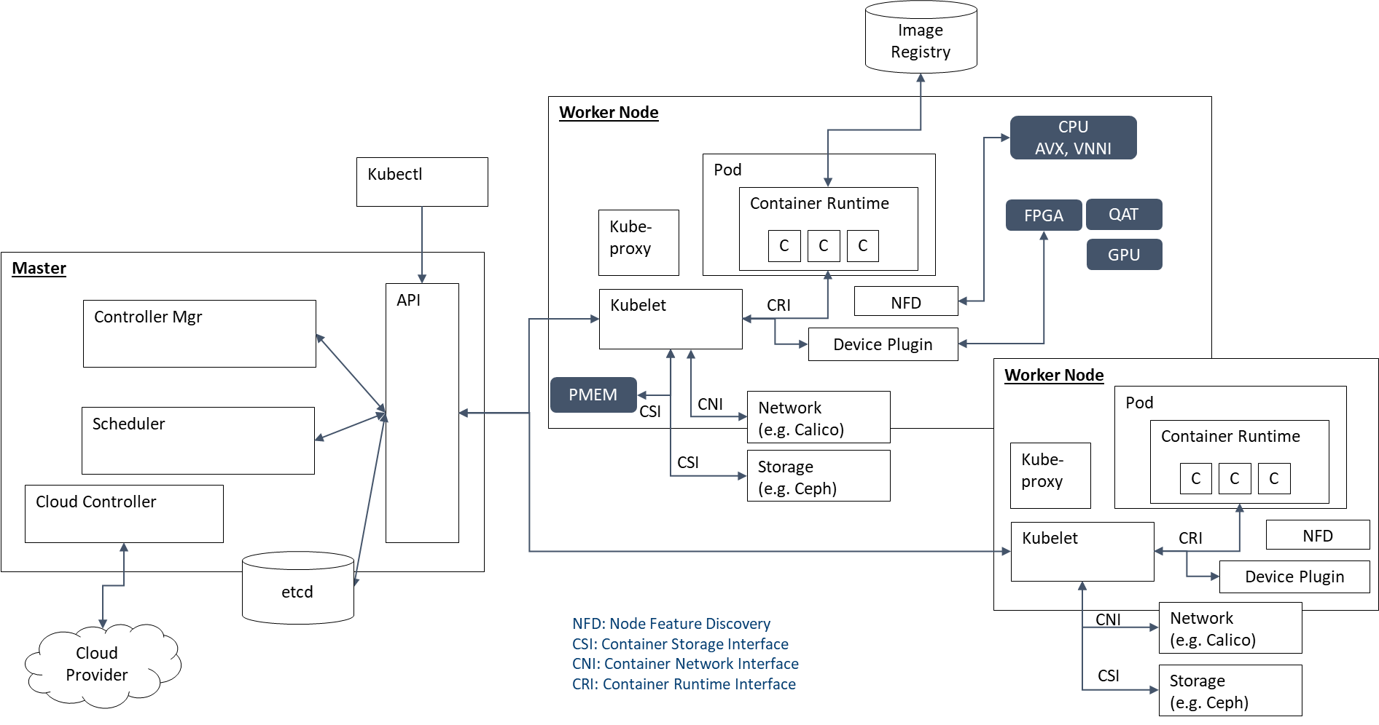
Kubernetes Architecture

Slide 60
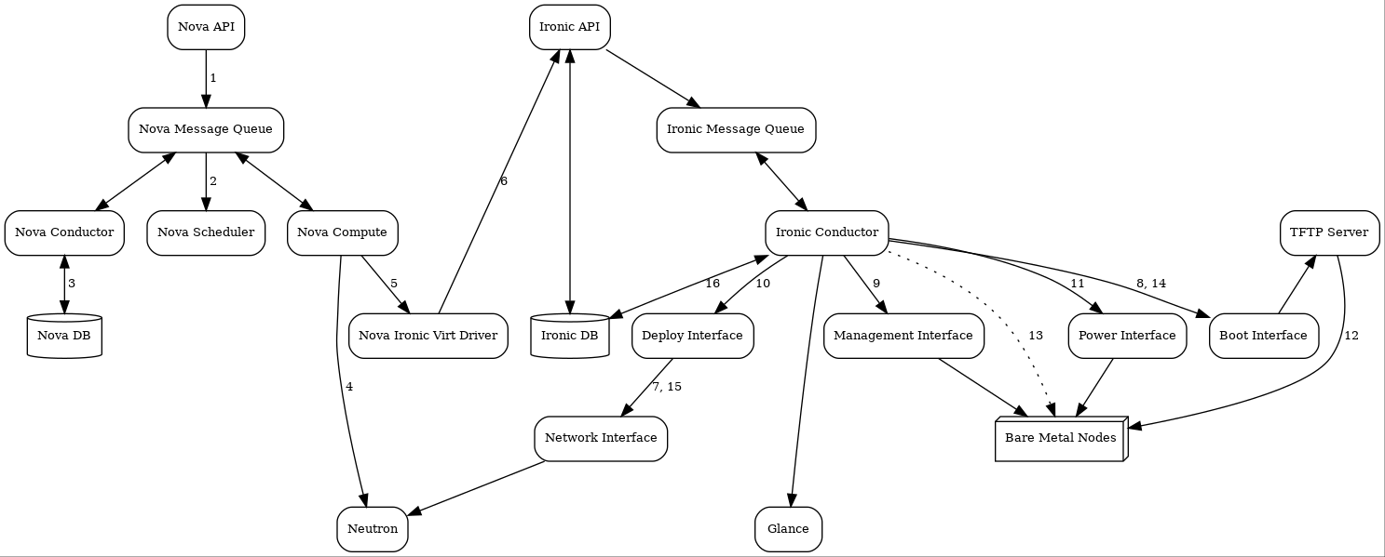
OpenStack Ironic Provisioning Workflow

